Slide 1
Energy Consumption Analysis
Prepared by Mayur and amit
Date : 28/04/2025

Slide 2
Agenda
Project Background
Data Collection and Preprocessing
Exploratory Data Analysis (EDA)

Slide 3
Introduction
Problem Statement:
Predict future energy consumption using historical data.
Why it matters:
Helps in energy planning, load management, and reducing wastage.

Slide 4
Dataset Overview
Source: UCI Electric Power Consumption Dataset (Kaggle)
Data Range: 2006–2010 (1-minute interval readings)
Key Features:
Date, Time
Global_active_power
Voltage
Sub_metering_1, _2, _3

Slide 5
Challenges in the Dataset
Missing Timestamps
Irregular Time Series
Outliers / Anomalies

Slide 6
Data Preprocessing
Steps Taken:
Combined Date and Time into a single datetime column.
Resampled data to hourly/daily for regular intervals.
Handled missing values (e.g., interpolation, forward fill).
Detected and removed outliers using z-score or IQR.

Slide 7
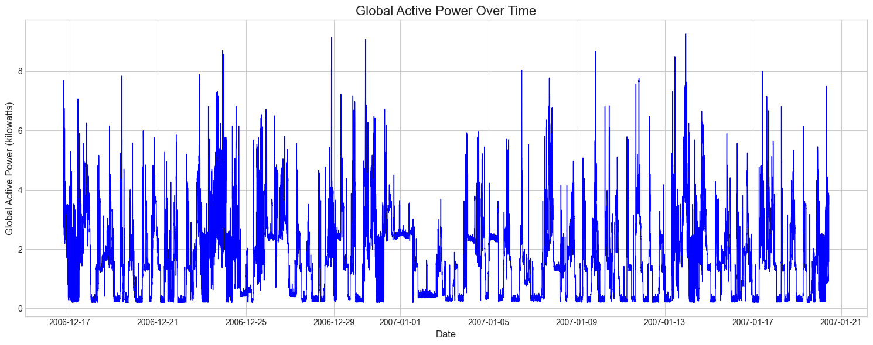
VISUALIZATION Line plot of Global_active_power over time
Global Active Power shows high volatility with regular spikes, typically ranging between 0-8 kilowatts, suggesting cyclical energy usage patterns throughout the monitored period.

Slide 8
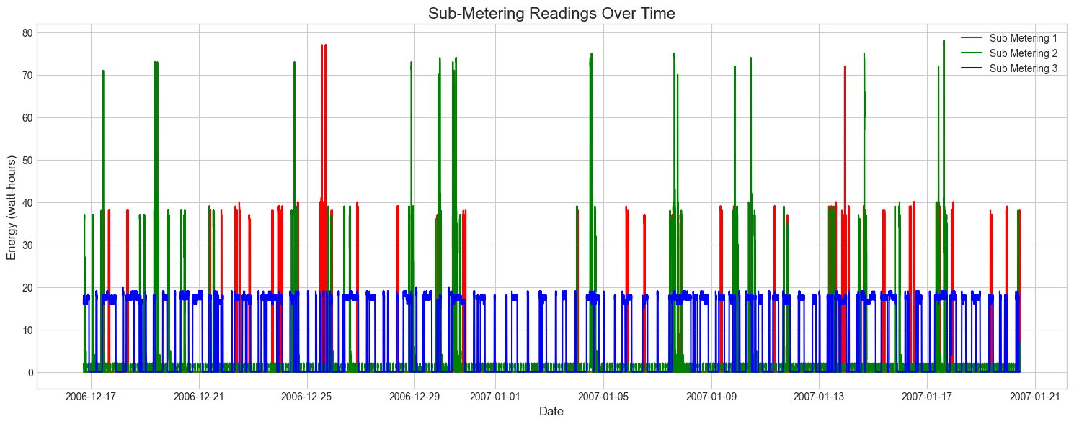
Multiple time series - Plot all three sub-metering values
Sub-metering readings reveal Sub-metering 3 (blue) maintains a consistent baseline around 18-20 watt-hours, while Sub-meterings 1 and 2 show intermittent activity with occasional high spikes reaching 70+ watt-hours.

Slide 9
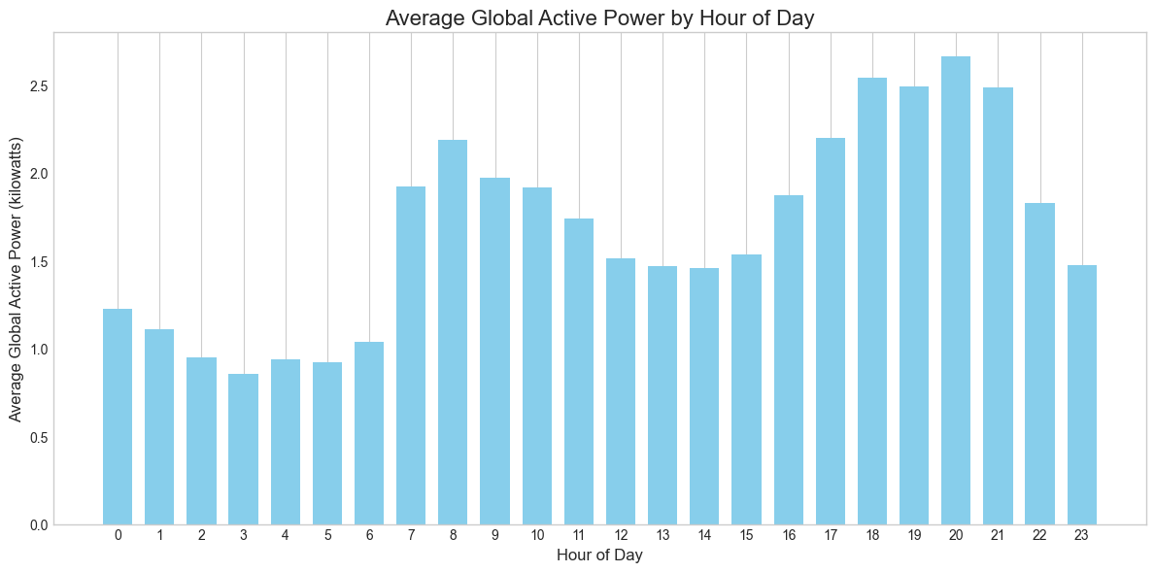
Daily/hourly average consumption
The hourly consumption pattern shows a clear bimodal distribution with peaks at 8-9 AM and 7-9 PM, with highest usage occurring during evening hours (peaking at 2.6+ kW around 8 PM).

Slide 10
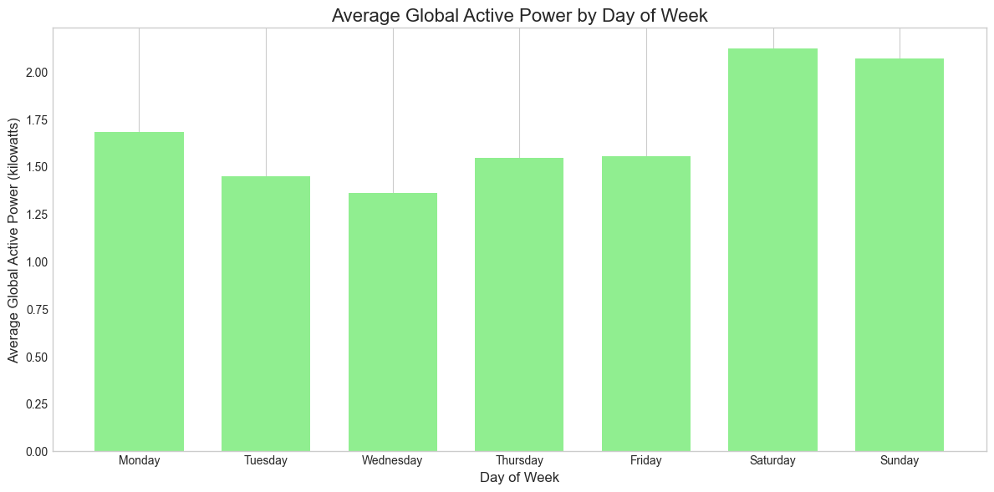
Day of week average
Weekend days (Saturday and Sunday) show significantly higher energy consumption (2+ kW) compared to weekdays, with Wednesday having the lowest average consumption (1.35 kW).

Slide 11
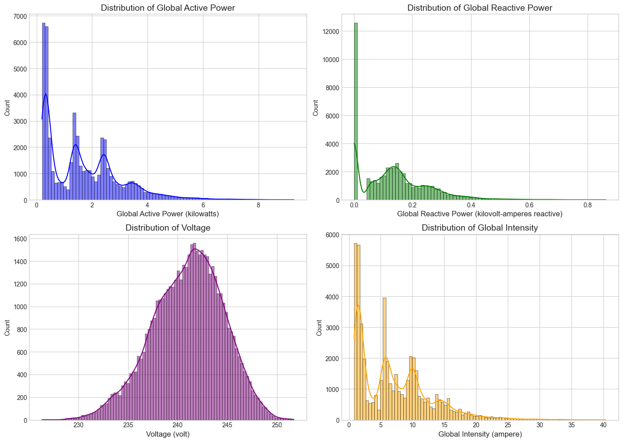
Histograms for each numerical variable
The histograms reveal multimodal distributions for Global Active and Reactive Power and Global Intensity, while Voltage follows a normal distribution centered around 240 volts.

Slide 12
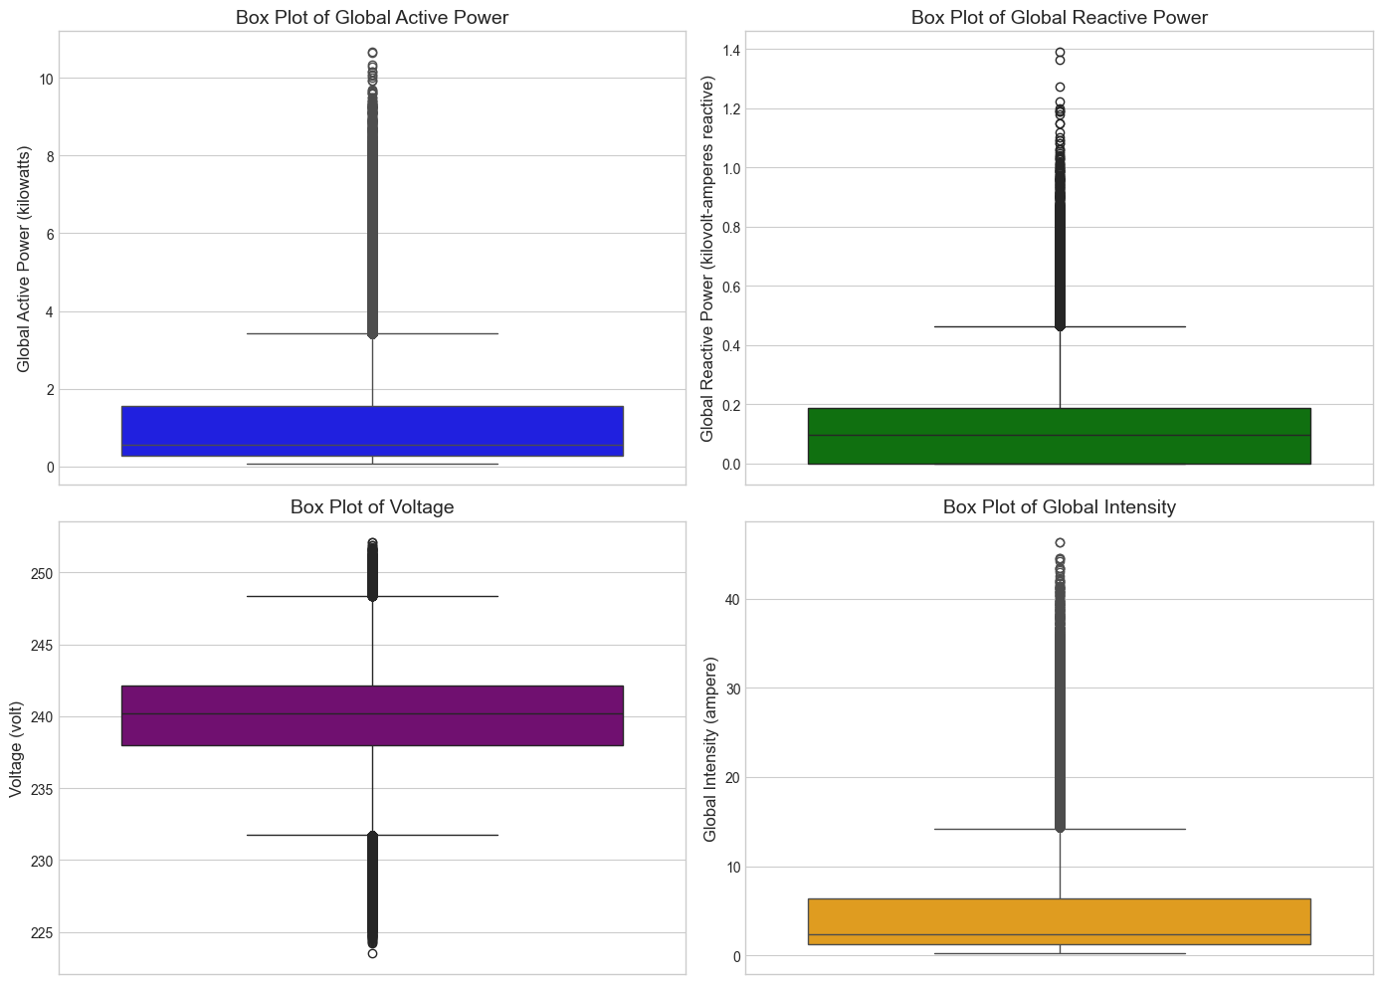
Box plots to identify outliers
Box plots highlight numerous outliers in all variables, especially in Global Active Power and Global Intensity, with voltage showing the most symmetric distribution.

Slide 13
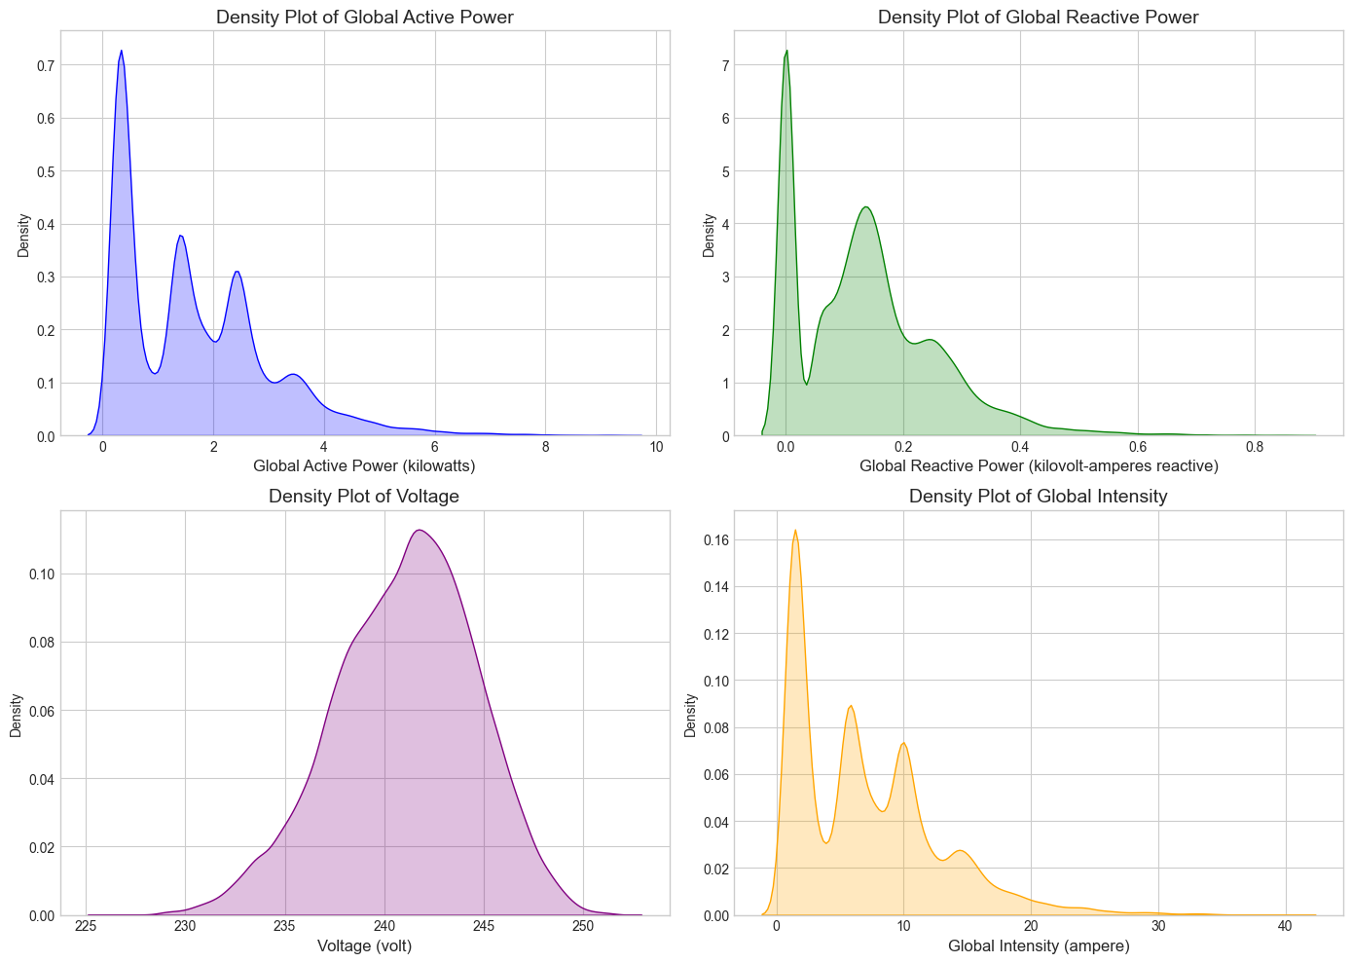
Density plots for continuous variables
Density plots confirm the multimodal nature of power and intensity distributions, with several distinct peaks indicating different usage states or modes of operation.

Slide 14
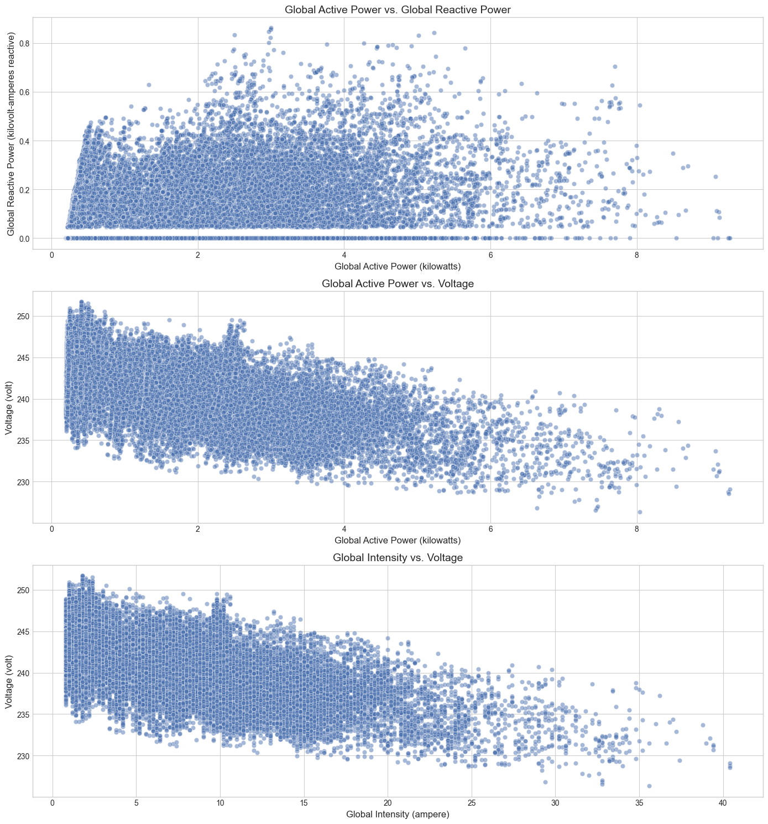
Scatter plots between variables
Scatter plots show a negative correlation between power and voltage (higher power consumption correlates with lower voltage), and an inverse relationship between intensity and voltage.

Slide 15
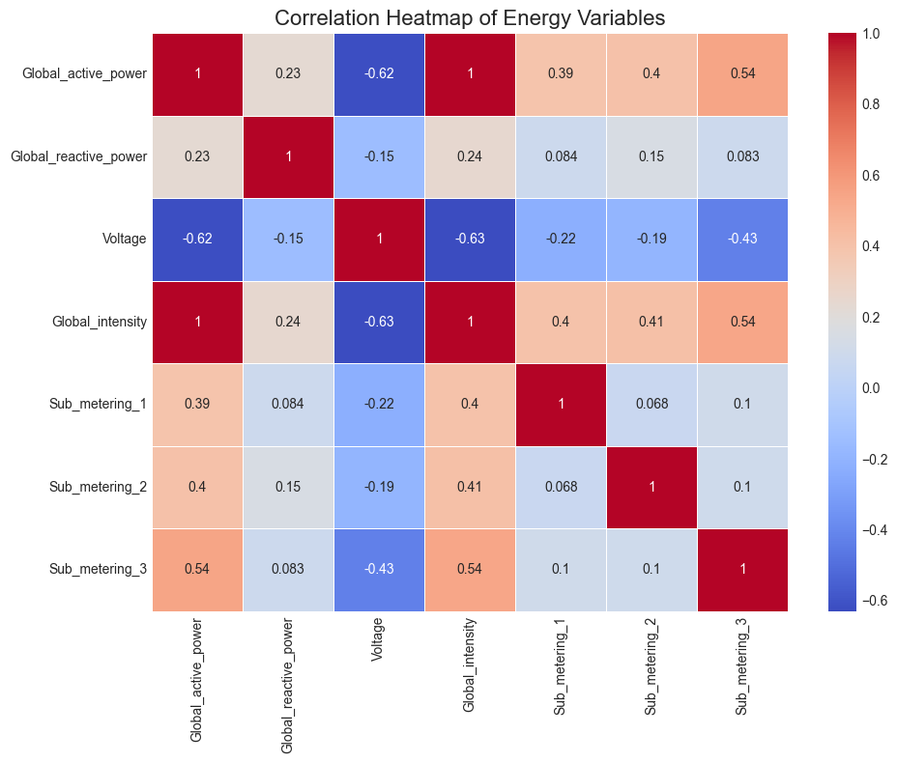
Correlation heatmap
The correlation heatmap confirms strong positive correlation (1.0) between Global Active Power and Global Intensity, moderate correlation (0.54) with Sub-metering 3, and significant negative correlation (-0.62) with Voltage.

Slide 16
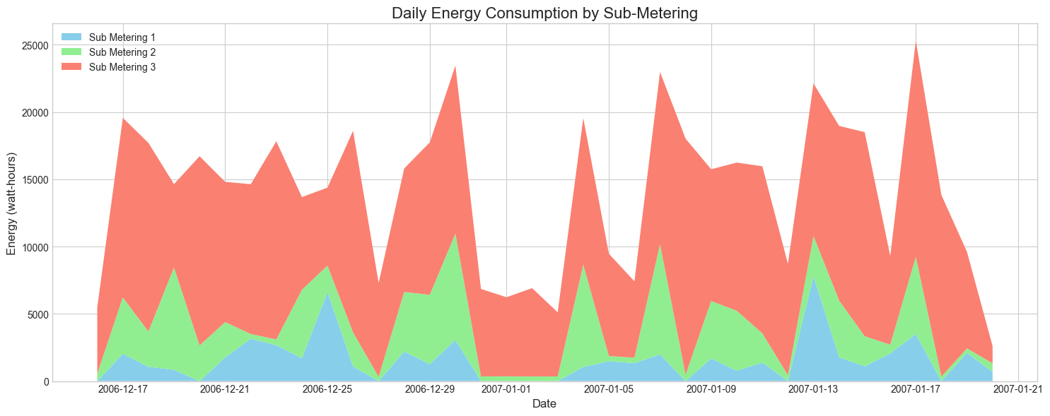
Stacked area chart Daily totals for stacked area chart
The stacked area chart shows Sub-metering 3 (red) contributes the majority of energy consumption, with pronounced cyclical patterns and occasional significant increases across all sub-meters.

Slide 17
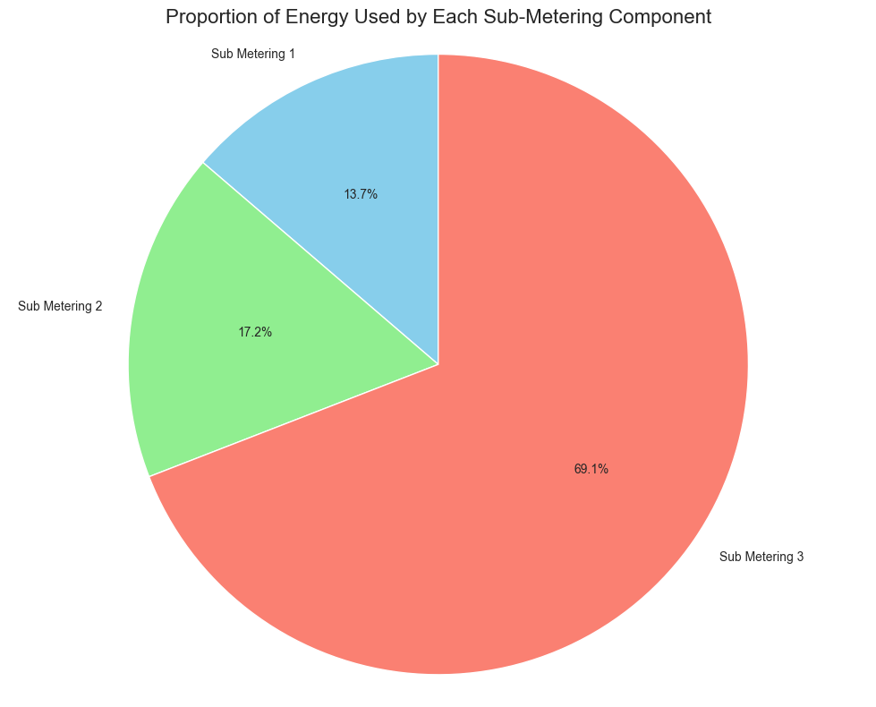
Pie chart
The pie chart quantifies that Sub-metering 3 accounts for 69.1% of total energy consumption, while Sub-meterings 2 and 1 contribute 17.2% and 13.7% respectively.

Slide 18
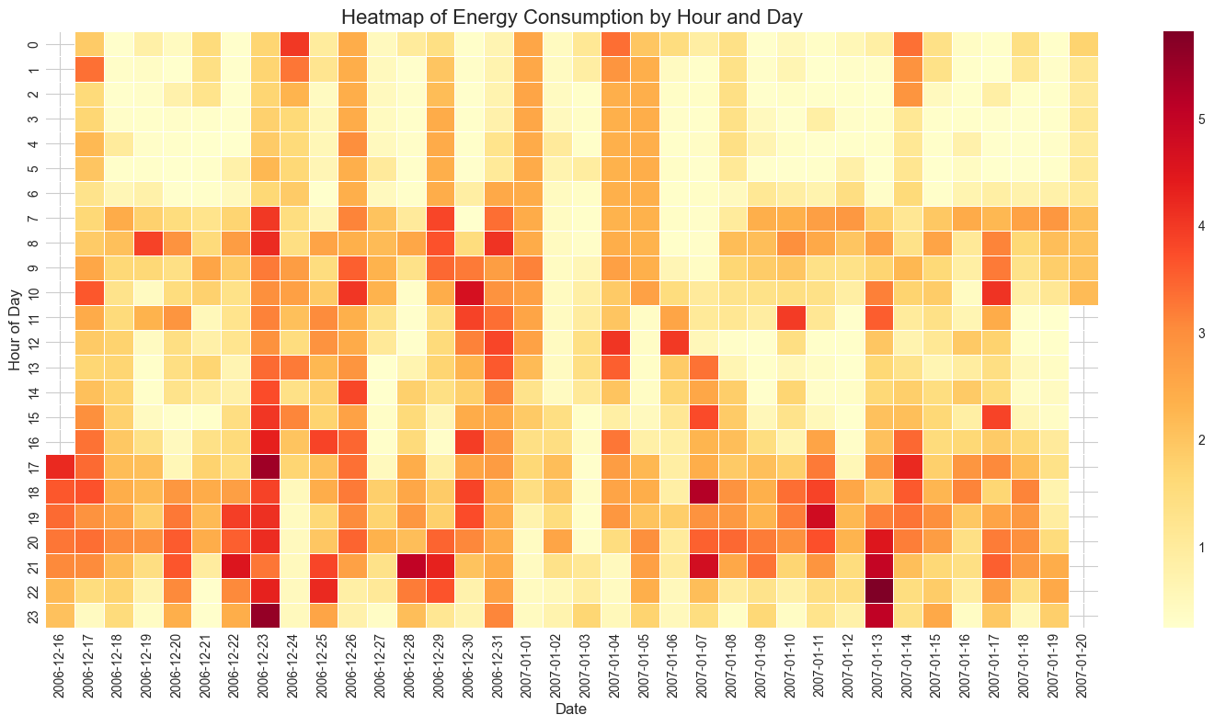
Heatmap of energy consumption by hour and day
The heatmap reveals higher energy consumption (darker colors) during evening hours (18-23), with distinctive day-to-day variations and some particularly high-usage periods shown in dark red.

Slide 19
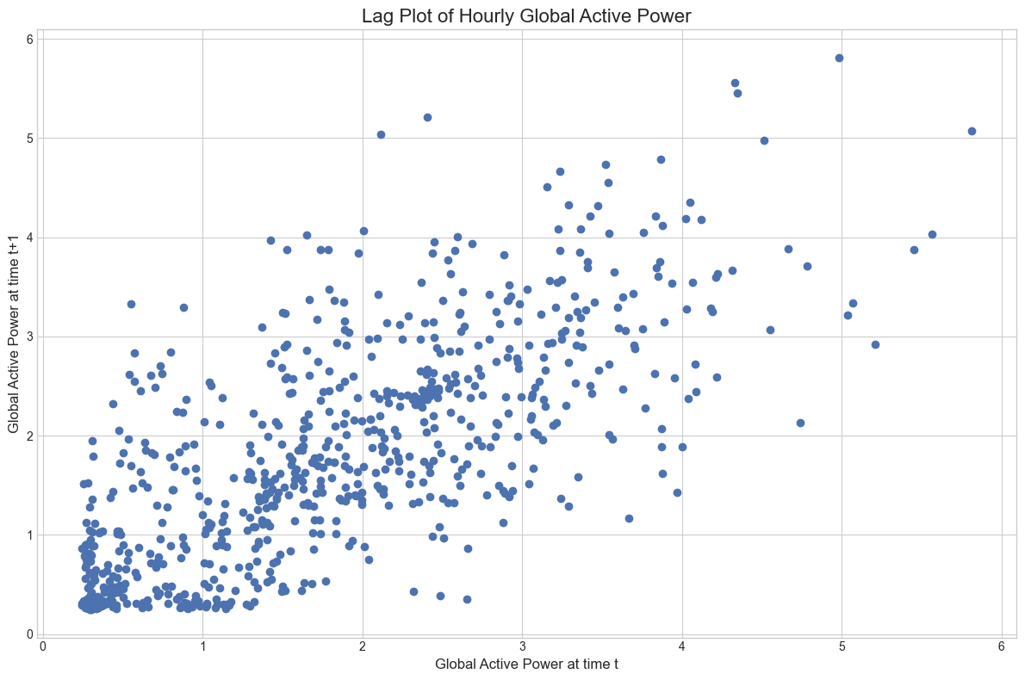
Lag plots to check for autocorrelation
The lag plot shows positive autocorrelation in hourly Global Active Power, with points clustered along a diagonal pattern, indicating that power usage in one hour tends to be similar to the previous hour.

Slide 20
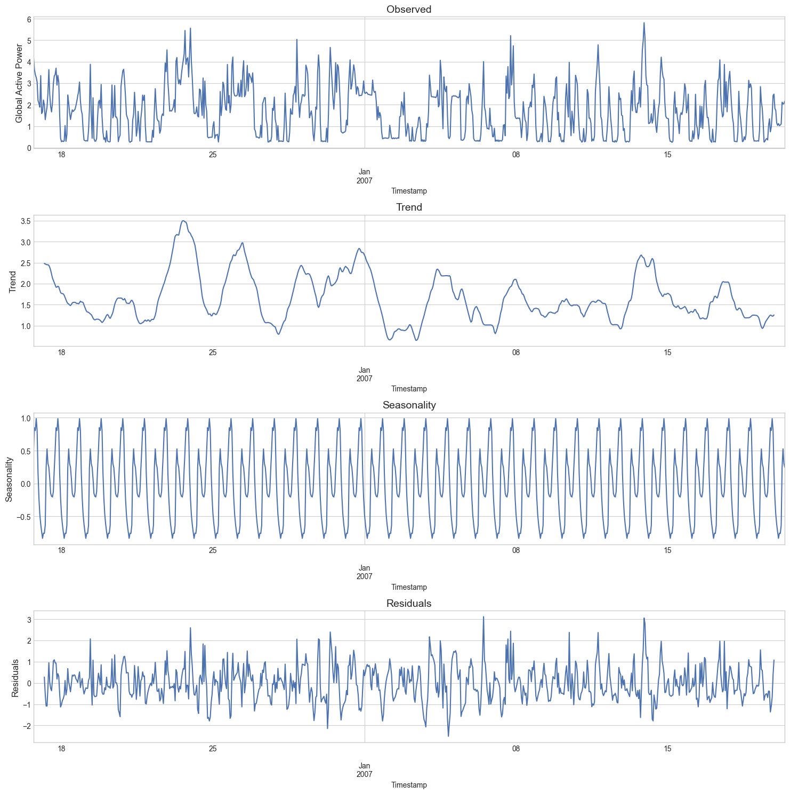
Decomposition plots
The decomposition plot separates the time series into observed data, trend (showing medium-term fluctuations), clear 24-hour seasonality patterns, and residuals (unexplained variations).

Slide 21
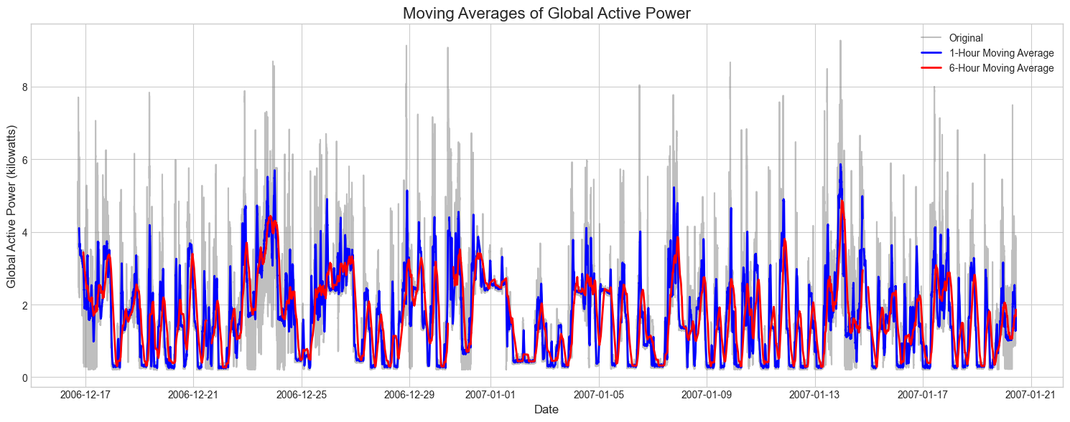
Moving average plots
Moving averages (1-hour in blue, 6-hour in red) smooth out the volatility in Global Active Power, highlighting underlying consumption patterns while filtering out short-term fluctuations.

